Slide 1


Slide 2
MED-FI PROTOTYPE
GABE / KAT / LEIGH / ODETTE

Slide 3
WHAT IS WONDERLUST?

Slide 4
WHAT IS WONDERLUST?
LEARN IN YOUR SPARE TIME

Slide 5
WHAT IS WONDERLUST?
LEARN IN YOUR SPARE TIME
“KILL TIME, NOT THE CAT”

Slide 6
OVERVIEW

Slide 7
OVERVIEW
TASKS
KEY CHANGES
DEMO
OUR TOOLS

Slide 8
OVERVIEW
TASKS
KEY CHANGES
DEMO
OUR TOOLS

Slide 9
OVERVIEW
TASKS
KEY CHANGES
DEMO
OUR TOOLS

Slide 10
OVERVIEW
TASKS
KEY CHANGES
DEMO
OUR TOOLS

Slide 11
OVERVIEW
TASKS
KEY CHANGES
DEMO
OUR TOOLS

Slide 12
TASKS
KEY CHANGES
DEMO
OUR TOOLS

Slide 13
TASKS
SIMPLE: BROWSE

Slide 14
TASKS
SIMPLE: BROWSE
MODERATE: RETRIEVE

Slide 15
TASKS
SIMPLE: BROWSE
MODERATE: RETRIEVE
COMPLEX: DISCOVER

Slide 16
TASKS
KEY CHANGES
DEMO
OUR TOOLS

Slide 17
KEY CHANGES
SEARCH

Slide 18
KEY CHANGES
SEARCH
NAVIGATION

Slide 19
KEY CHANGES
SEARCH
NAVIGATION
NAMING

Slide 20
KEY CHANGES
SEARCH
NAVIGATION
NAMING
ASSETS

Slide 21
SEARCH

Slide 22
SEARCH
PROBLEM:

Slide 23
SEARCH
PROBLEM:
Search for Content

Slide 24
SEARCH
PROBLEM:
Search for Content
Home Screen

Slide 25
SEARCH
PROBLEM:
Search for Content
Home Screen
Within Categories

Slide 26
SEARCH
PROBLEM:
Search for Content
Home Screen
Within Categories
SOLUTION:

Slide 27
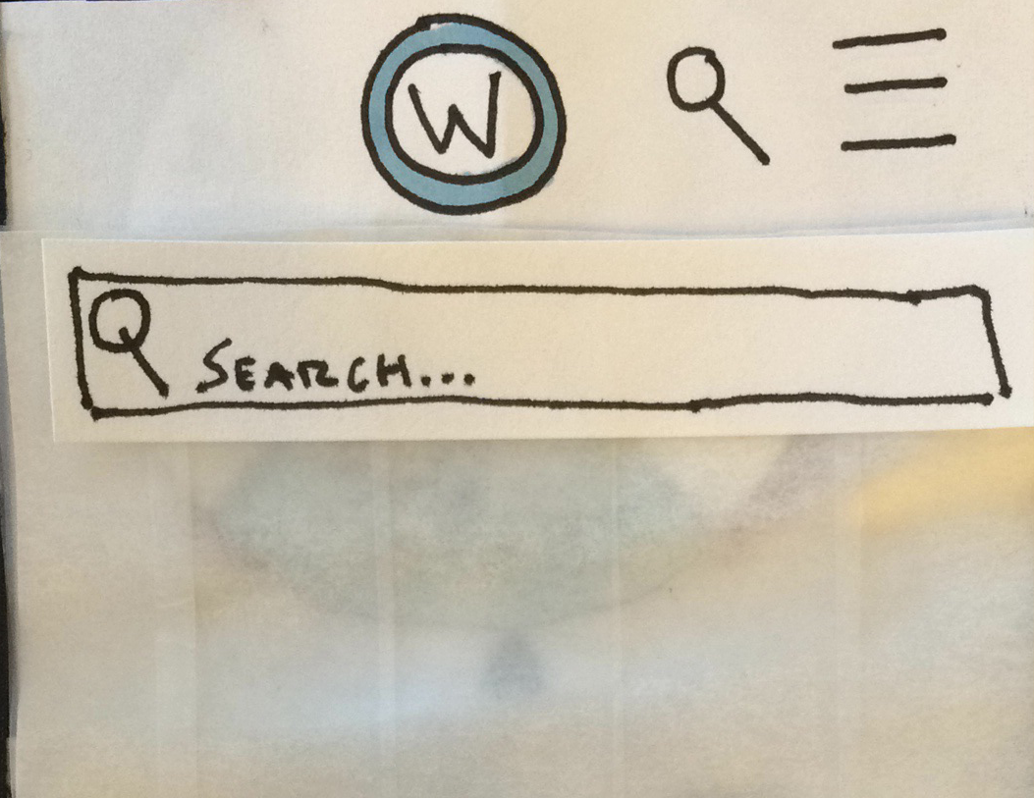
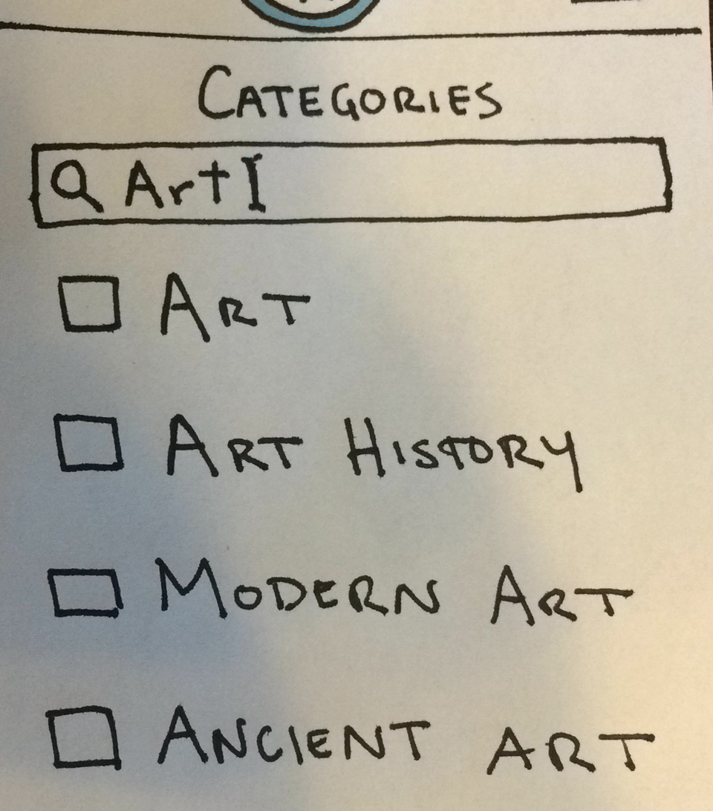
SEARCH
PROBLEM:
Search for Content
Home Screen
Within Categories
SOLUTION:
Universal/Localized Search Buttons

Slide 28
NAVIGATION

Slide 29
NAVIGATION
PROBLEM:

Slide 30
NAVIGATION
PROBLEM:
Getting Home

Slide 31
NAVIGATION
PROBLEM:
Getting Home
Viewing Past Stories

Slide 32
NAVIGATION
PROBLEM:
Getting Home
Viewing Past Stories
SOLUTION:

Slide 33
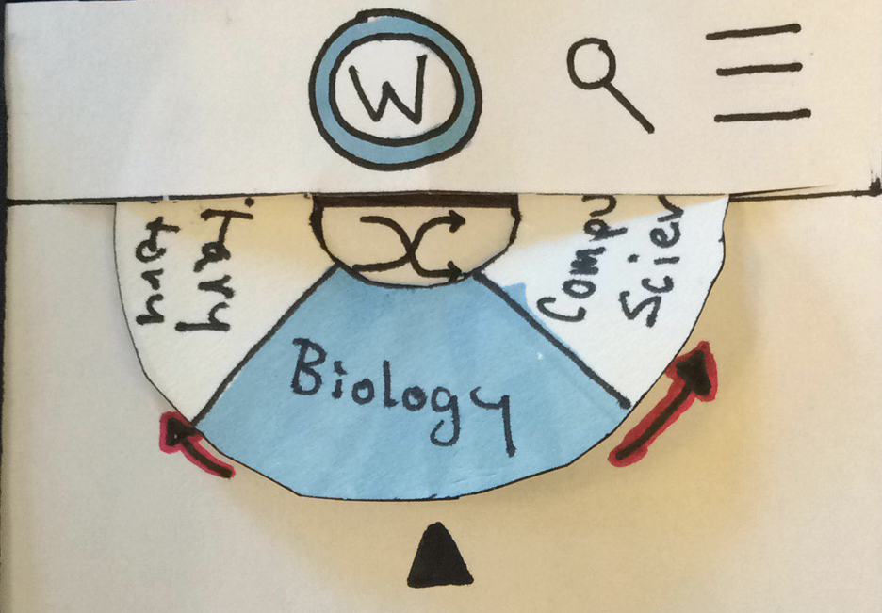
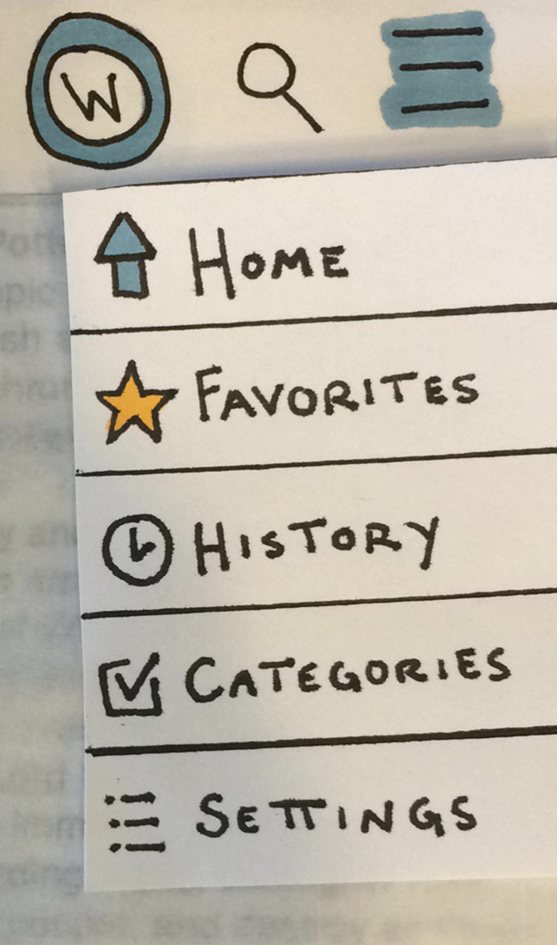
NAVIGATION
PROBLEM:
Getting Home
Viewing Past Stories
SOLUTION:
Universal Buttons

Slide 34
NAVIGATION
PROBLEM:
Getting Home
Viewing Past Stories
SOLUTION:
Universal Buttons

Slide 35
NAVIGATION
PROBLEM:
Getting Home
Viewing Past Stories
SOLUTION:
Universal Buttons

Slide 36
NAMING

Slide 37
NAMING
PROBLEM:

Slide 38
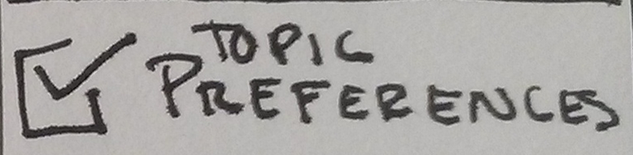
NAMING
PROBLEM:

Slide 39
NAMING
PROBLEM:
“What are ‘topics’?”

Slide 40
NAMING
PROBLEM:
“What are ‘topics’?”
SOLUTION:

Slide 41
NAMING
PROBLEM:
“What are ‘topics’?”
SOLUTION:
Rename to ‘Categories’

Slide 42
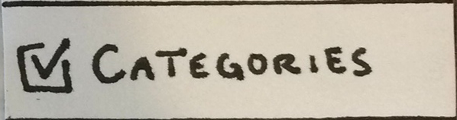
NAMING
PROBLEM:
“What are ‘topics’?”
SOLUTION:
Rename to ‘Categories’

Slide 43
ASSETS

Slide 44
ASSETS
PROBLEM:

Slide 45
ASSETS
PROBLEM:
Bland/Non-intuitive Assets

Slide 46
ASSETS
PROBLEM:
Bland/Non-intuitive Assets
SOLUTION:

Slide 47
ASSETS
PROBLEM:
Bland/Non-intuitive Assets
SOLUTION:
Color Scheme

Slide 48
ASSETS
PROBLEM:
Bland/Non-intuitive Assets
SOLUTION:
Color Scheme
Stylized Icons/Screens

Slide 49

ASSETS
PROBLEM:
Bland/Non-intuitive Assets
SOLUTION:
Color Scheme
Stylized Icons/Screens

Slide 50
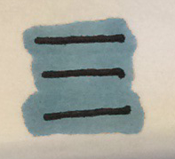
ASSETS
PROBLEM:
Bland/Non-intuitive Assets
SOLUTION:
Color Scheme
Stylized Icons/Screens

Slide 51

ASSETS
PROBLEM:
Bland/Non-intuitive Assets
SOLUTION:
Color Scheme
Stylized Icons/Screens

Slide 52
TASKS
KEY CHANGES
DEMO
OUR TOOLS

Slide 53
DEMO
WONDERLUST MARVEL PROTOTYPE:
marvelapp.com/4j5f8b

Slide 54
TASKS
KEY CHANGES
DEMO
OUR TOOLS

Slide 55
TOOLS
Modified Low-Fi

Slide 56
TOOLS
Modified Low-Fi
Marvel App

Slide 57
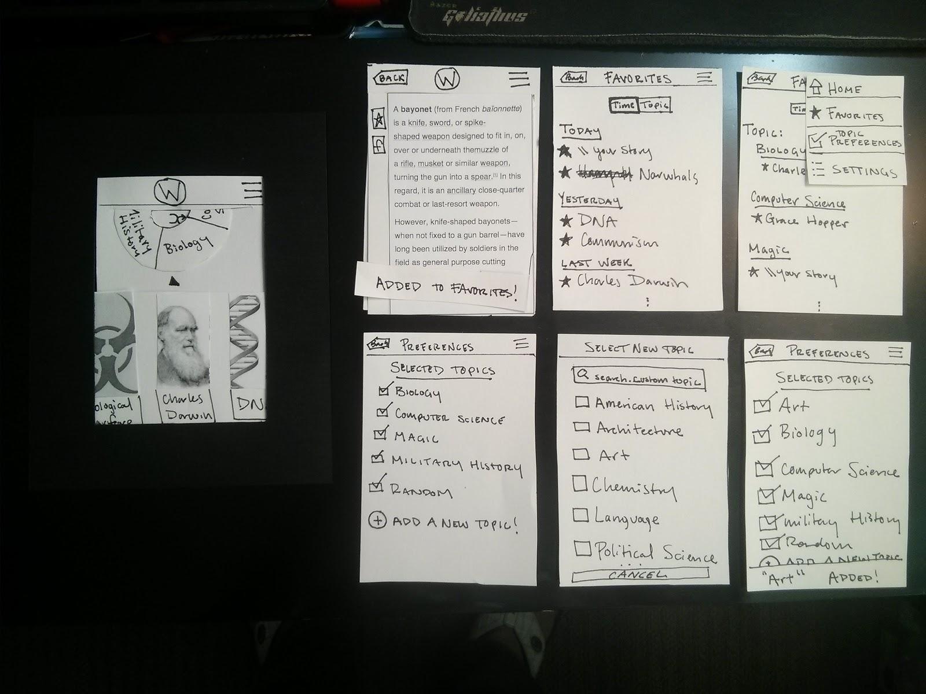
TOOLS
Physical Prototype:
Paper Media
Wikipedia
By Hand + Printer

Slide 58
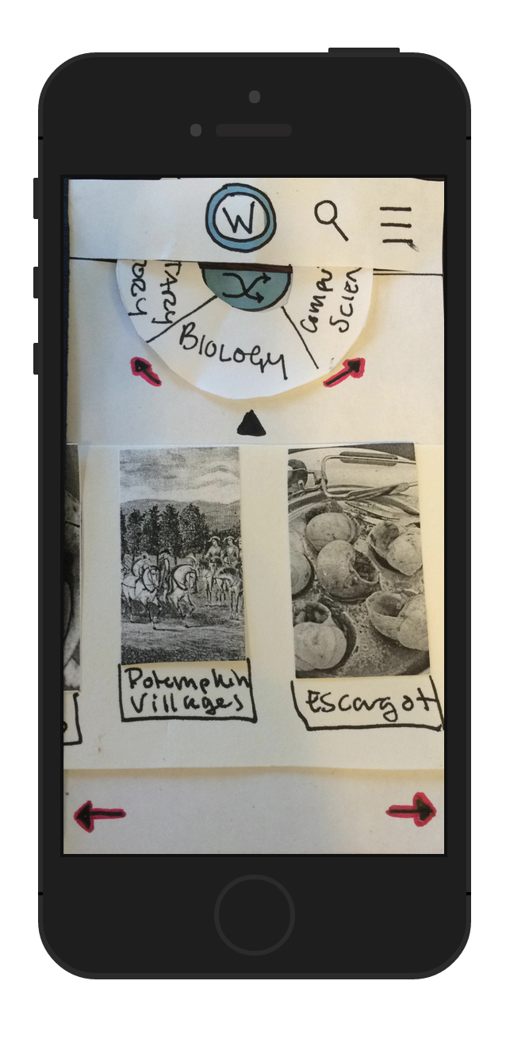
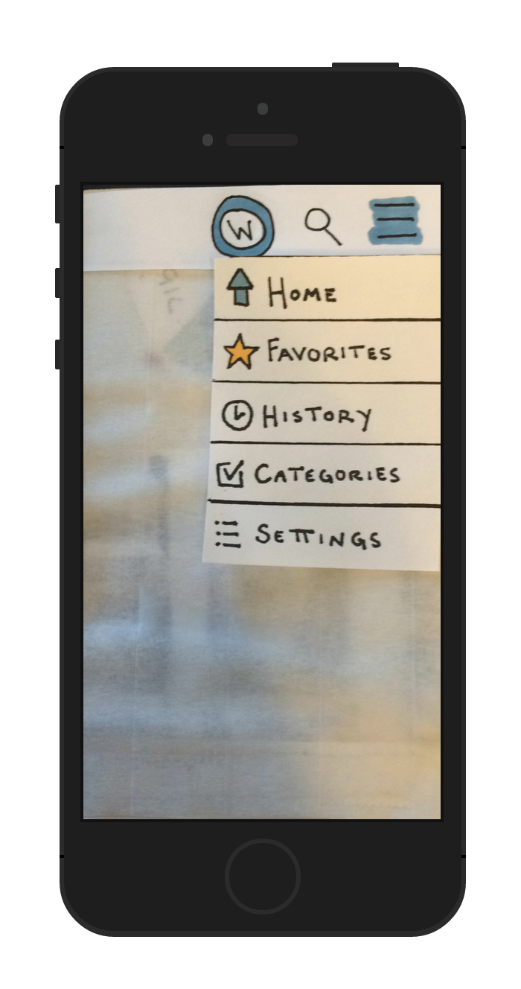
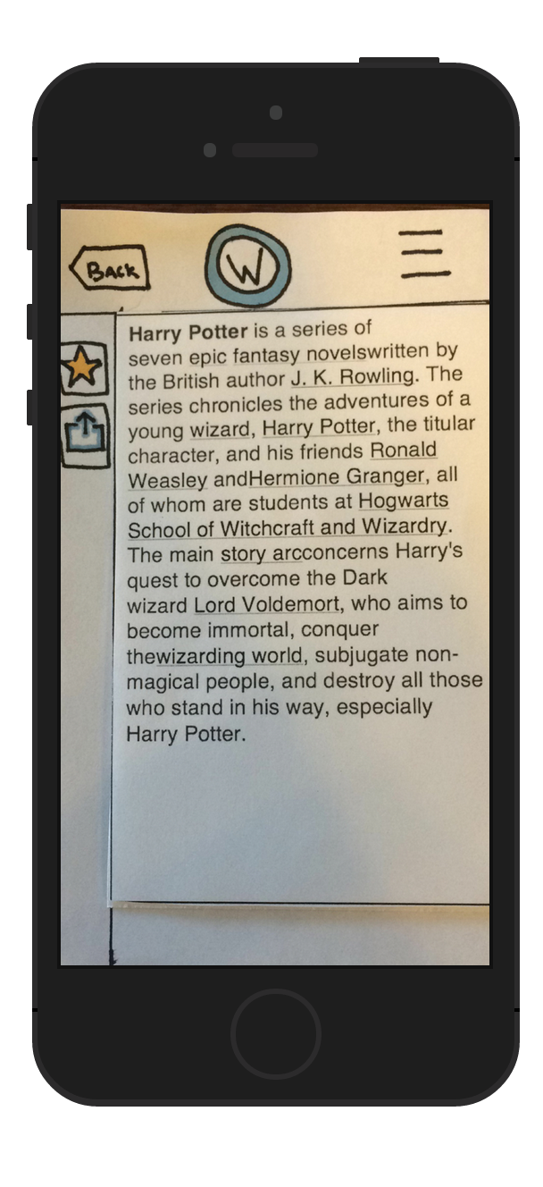
TOOLS
Computer Prototype:
Marvel App

Slide 59
MARVEL : PROS

Slide 60
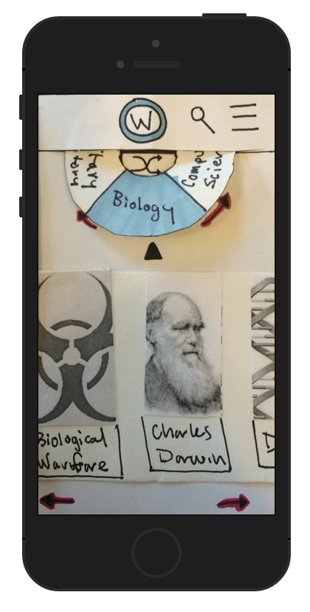
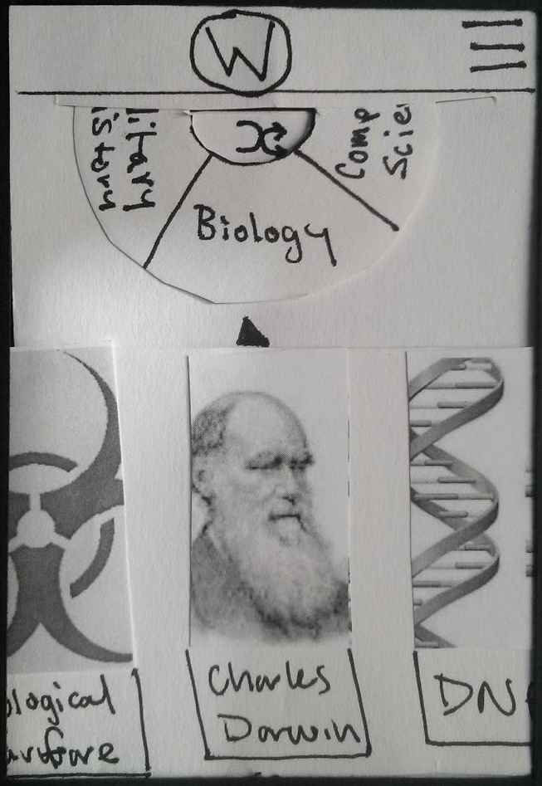
MARVEL : PROS
Easy to adapt paper prototype

Slide 61
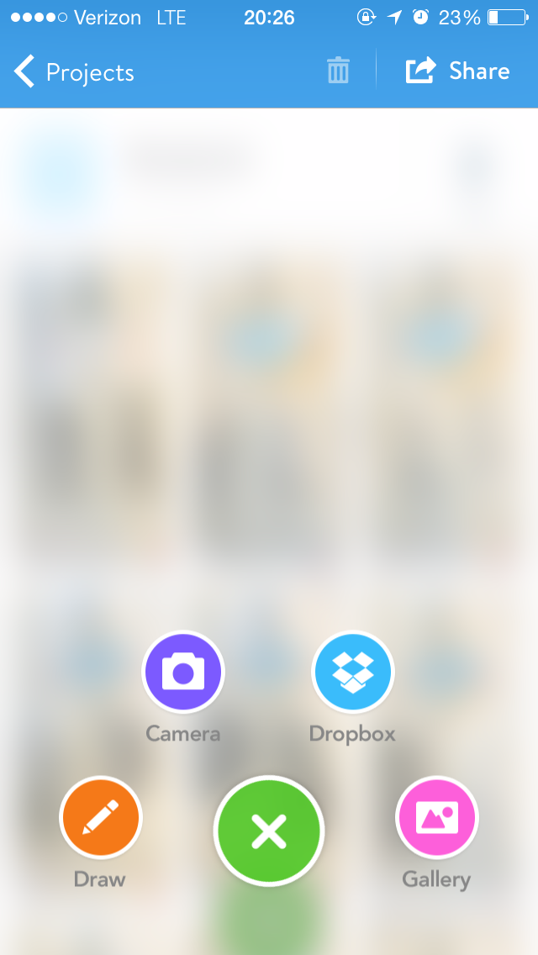
MARVEL : PROS
Easy to adapt paper prototype
Uses iPhone Camera

Slide 62
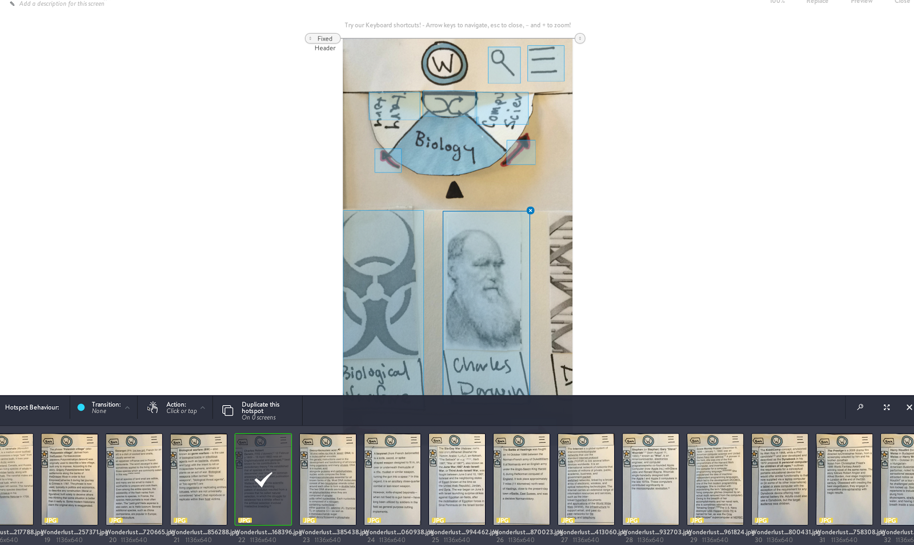
MARVEL : PROS
Easy to adapt paper prototype
Uses iPhone Camera
Very intuitive interface

Slide 63
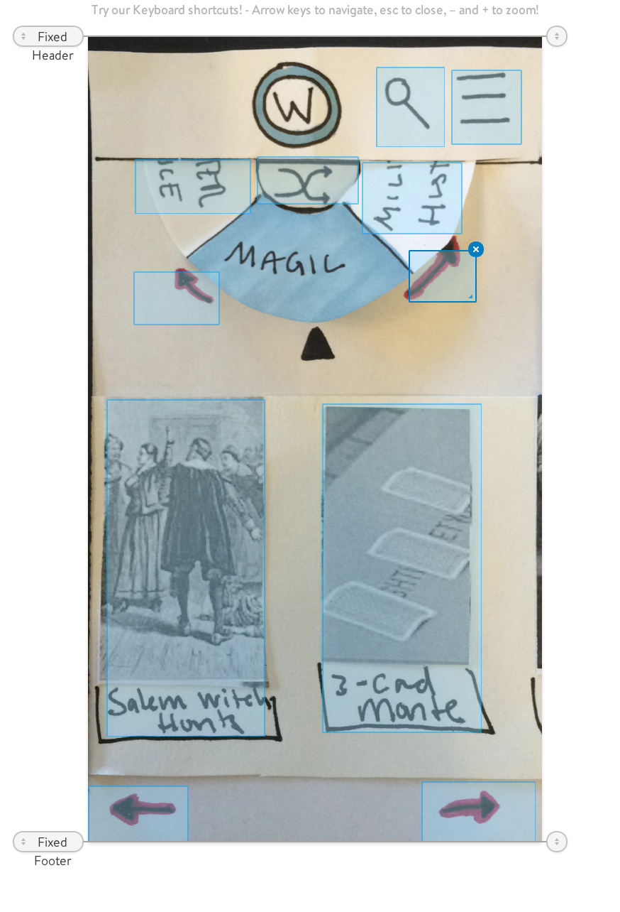
MARVEL : PROS
Easy to adapt paper prototype
Uses iPhone Camera
Very intuitive interface
Touch ‘hot spots’

Slide 64
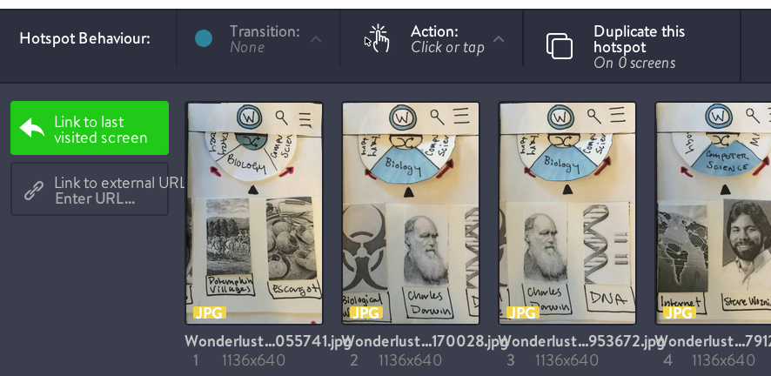
MARVEL : PROS
Easy to adapt paper prototype
Uses iPhone Camera
Very intuitive interface
Touch ‘hot spots’
Links to other photos/previous

Slide 65
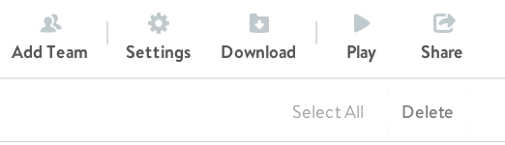
MARVEL : PROS
Easy to adapt paper prototype
Uses iPhone Camera
Very intuitive interface
Touch ‘hot spots’
Links to other photos/previous
Ready to use out of the box/easily implement WoOz

Slide 66
MARVEL : CONS

Slide 67
MARVEL : CONS
No Gesture Support

Slide 68
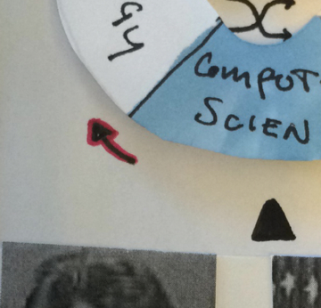
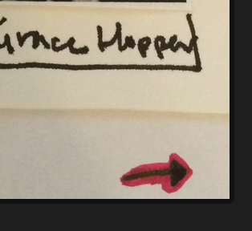
MARVEL : CONS
No Gesture Support

Slide 69
MARVEL : CONS
No Gesture Support
Cross-Platform Consistency
Issues

Slide 70
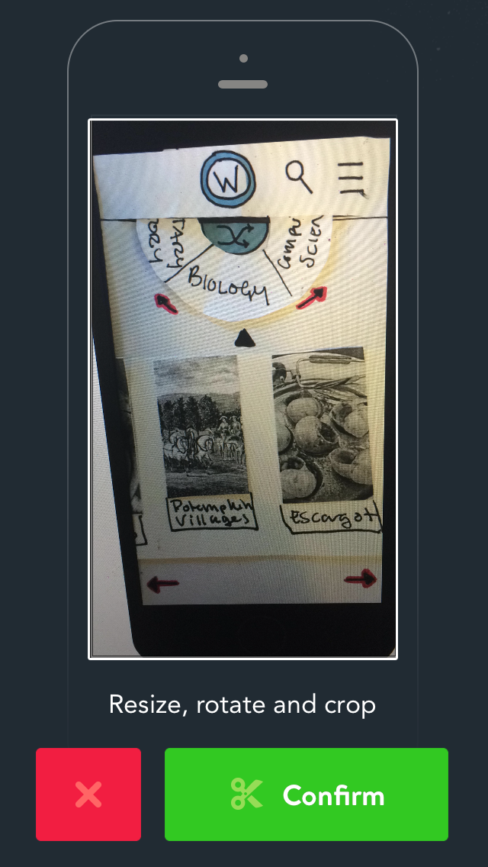
MARVEL : CONS
No Gesture Support
Cross-Platform Consistency
Issues

Slide 71
MARVEL : CONS
No Gesture Support
Cross-Platform Consistency
Issues
Multiple Editors = $

Slide 72
OVERVIEW
TASKS
KEY CHANGES
DEMO
OUR TOOLS

Slide 73
THANK YOU!

